Slide 1


毕业论文答辩模板
——
The grown-ups' response, this time, was to advise me to lay aside my drawings of boa constrictors,
whether from the inside or the outside, and devote myself instead to geography, history, arithmetic and grammar. That is why, at the age
答辩人：半想象现实
指导老师：水木清华

Slide 2
目录
CONTENTS
01.
课题背景及研究内容
If someone loves a flower, of which just one single
02.
研究思路可行性分析
If someone loves a flower, of which just one single
03.
课题现状及发展趋势
If someone loves a flower, of which just one single
04.
后记总结及参考文献
If someone loves a flower, of which just one single

Slide 3
Chapter 01
课题背景及研究内容
If someone loves a flower, of which just one single blossom grows in all the millions and millions of starsIf someone loves a flower, of which just one single blossom grows

Slide 4

课题背景及研究内容
If someone loves a flower, of which just one single
TITLE HERE
TITLE HERE
TITLE HERE
He was an old man who fished alone in a skiff in the
He was an old man who fished alone in a skiff in the
He was an old man who fished alone in a skiff in the

Slide 5
课题背景及研究内容
If someone loves a flower, of which just one single
TEXT HERE
Once when I was six years old I saw a magnificent picture in a book, called True Stories from Nature, about the primeval forest. It was a picture of a boa constrictor in the act of swallowing an animal. Here is a copy of the drawing.
TEXT HERE
TEXT HERE
If someone loves a flower, of which just one single blossom grows
If someone loves a flower, of which just one single blossom grows

Slide 6
Chapter 02
研究思路可行性分析
If someone loves a flower, of which just one single blossom grows in all the millions and millions of starsIf someone loves a flower, of which just one single blossom grows

Slide 7
课题背景及研究内容
If someone loves a flower, of which just one single
TITLE HERE
A
TITLE HERE
And after some work with a colored pencil I succeeded in making my first drawing.
B
And after some work with a colored pencil I succeeded in making my first drawing.
TITLE HERE
C
TITLE HERE
And after some work with a colored pencil I succeeded in making my first drawing.
D
And after some work with a colored pencil I succeeded in making my first drawing.

Slide 8
课题背景及研究内容
If someone loves a flower, of which just one single
TITLE HERE
TITLE HERE
TITLE HERE
TITLE HERE
And after some work with a colored pencil I succeeded in making my first drawing.
And after some work with a colored pencil I succeeded in making my first drawing.
And after some work with a colored pencil I succeeded in making my first drawing.
And after some work with a colored pencil I succeeded in making my first drawing.
TITLE HERE
Perfect Concept
TITLE HERE
TITLE HERE
TITLE HERE

Slide 9
Chapter 03
课题现状及发展趋势
If someone loves a flower, of which just one single blossom grows in all the millions and millions of starsIf someone loves a flower, of which just one single blossom grows

Slide 10
课题背景及研究内容
If someone loves a flower, of which just one single
TITLE HERE
TITLE HERE
TITLE HERE
TITLE HERE
And after some work with a colored pencil I succeeded in making my first drawing.
And after some work with a colored pencil I succeeded in making my first drawing.
And after some work with a colored pencil I succeeded in making my first drawing.
And after some work with a colored pencil I succeeded in making my first drawing.

Slide 11
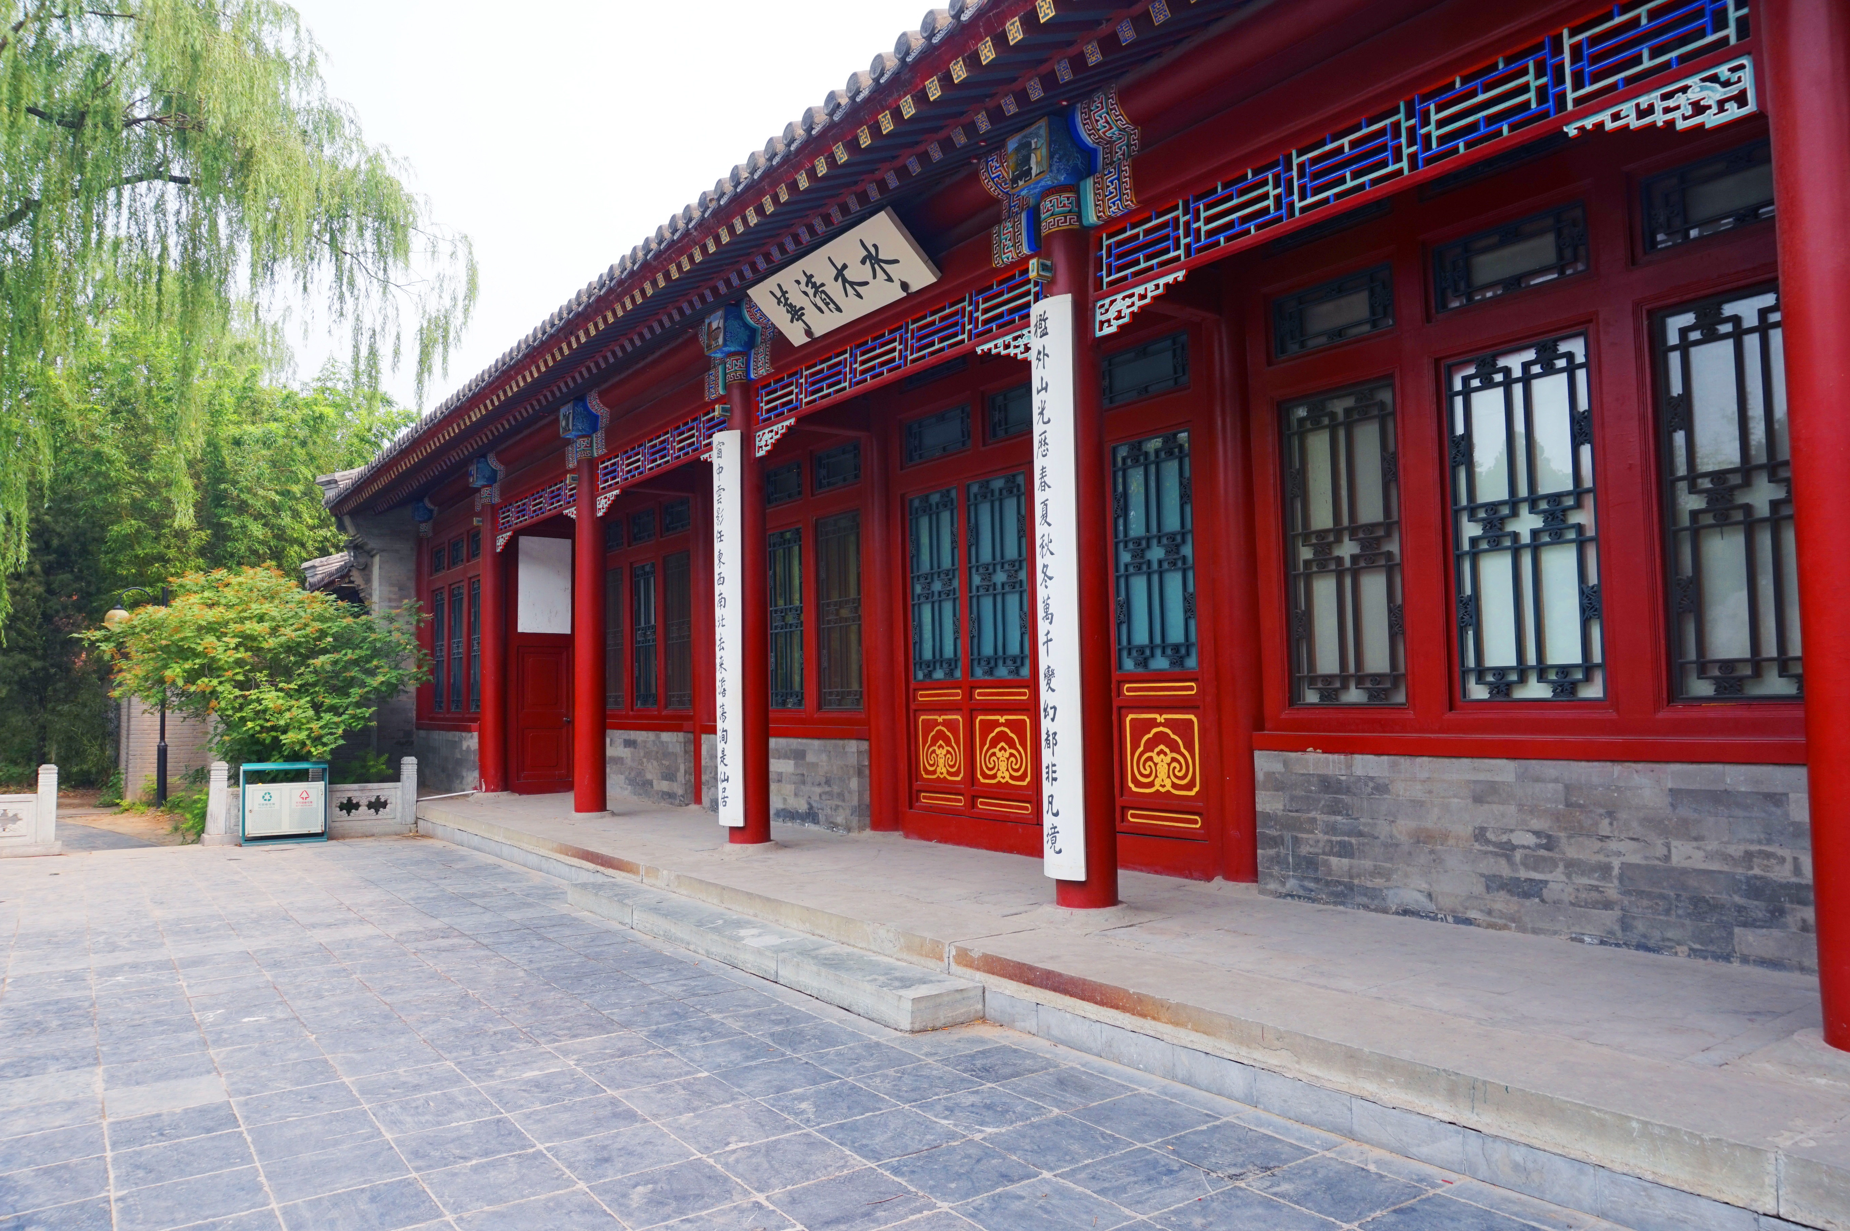
课题背景及研究内容
If someone loves a flower, of which just one single
TEXT HERE
TEXT HERE
If someone loves a flower, of which just one single blossom grows
If someone loves a flower, of which just one single blossom grows
TEXT HERE
TEXT HERE
If someone loves a flower, of which just one single blossom grows
If someone loves a flower, of which just one single blossom grows

Slide 12
Chapter 04
后记总结及参考文献
If someone loves a flower, of which just one single blossom grows in all the millions and millions of starsIf someone loves a flower, of which just one single blossom grows

Slide 13


课题背景及研究内容
If someone loves a flower, of which just one single
My drawing was not a picture of a hat. It was a picture of a boa constrictor digesting an elephant. But since the grown-ups were not able to understand it, I made another drawing: I drew the inside of the boa constrictor, so that the grown-ups could see it clearly. They always need to have things explained. My Drawing Number Two looked like this:
TEXT HERE
And after some work with a colored pencil I succeeded in making my first drawing. And after some work
TEXT HERE
And after some work with a colored pencil I succeeded in making my first drawing. And after some work

Slide 14

课题背景及研究内容
If someone loves a flower, of which just one single
TITLE HERE
If someone loves a flower, of which just one single blossom grows in all the millions and millions of stars
If someone loves a flower, of which just one single blossom grows in all the millions and millions of stars, it is enough to make him happy just to look at the stars. He can say to himself, “Somewhere, my flower is there…”
TITLE HERE
If someone loves a flower, of which just one single blossom grows in all the millions and millions of stars
TITLE HERE
If someone loves a flower, of which just one single blossom grows in all the millions and millions of stars

Slide 15
感谢各位指导老师
——
The grown-ups' response, this time, was to advise me to lay aside my drawings of boa constrictors,
whether from the inside or the outside, and devote myself instead to geography, history, arithmetic and grammar. That is why, at the age
答辩人：半想象现实
指导老师：水木清华

Slide 16


半想象现实
专注演示文稿制作
商业展映｜新品发布
年终总结｜求职竞聘
个人简历｜毕业答辩
企业画报｜成长相册
年会颁奖｜节日庆典
更多优质PPT模板
请搜索：http://chn.docer.com/works/?userid=199927538

